Slide 1
Giving a model your knowledge: retrieval-augmented generation, long context and fine-tuning
How do I give an AI model my company’s knowledge, and when is each way worth it?
Applied AI and Automation | Session 9 of the 15 (Sessions 0 to 14)
KLAi Professional Learning | Jotham Martin Wambi
Notes:
Welcome to Session 9. Last time you learned to write a strong prompt and to test it. But a prompt can only work with what the model already holds, and the model has not read your handbook, your contracts or your price lists. So our question today is this: how do I give an AI model my company’s knowledge, and when is each way worth it?
You see three ways, in the order a sensible company tries them: prompting, retrieval-augmented generation and fine-tuning, each built from ideas you already have, with real numbers from real runs on a handbook.

Slide 2



Today in one view: what you will leave with
By the end of today you will have
Describe three ways to give a model your knowledge, and the order to try them in
Read the real similarity scores of a retrieval step and say where it can miss
Explain what LoRA fine-tuning changes, and choose prompting, RAG or fine-tuning for a request
Notes:
To answer that question, here is what you leave with today. You can describe three ways to give a model your knowledge, prompting, retrieval-augmented generation and fine-tuning, and the order to try them. You can read the real scores of a retrieval step and say where it can miss.
And you can explain what LoRA fine-tuning changes inside a model, and choose a method for a request from your own job. Nothing to hand in and nothing to be tested on.

Slide 3
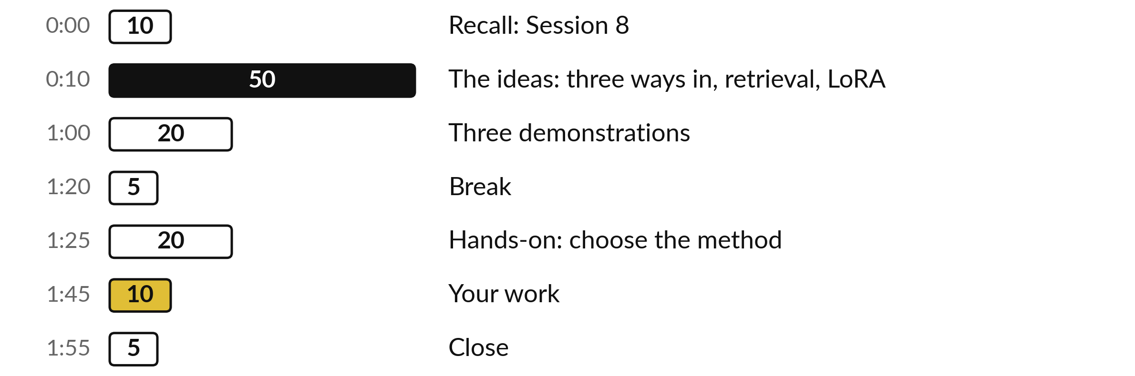
Your two hours: prompting, RAG
and fine-tuning, built step by step
Fifty minutes of ideas, twenty of demonstrations, then a paper exercise.
Notes:
Here is how the two hours get you there. After a short recall of Session 8, fifty minutes on the ideas, in order: the problem, then prompting, then retrieval-augmented generation built from what you know about tokens, embeddings and cosine similarity, then long context, then fine-tuning built from the training loop and a small table of numbers.
Twenty minutes go to three demonstrations on the handbook of Nile Valley Foods. After the break, twenty minutes on a paper exercise without a computer, and ten on what this means for your own job.

Slide 4

Three questions from last time
1. Name the five parts of a strong prompt.
2. Why ask a model for structured output?
3. What is accuracy on an evaluation set?
Answer aloud first. Then we check together.
Notes:
Three quick questions from Session 8. Answer aloud first, and then we check together. It is a warm-up to bring last time back.
Question one. Name the five parts of a strong prompt. Take a moment.
A good answer is this. Role, context, examples, output format and constraints; and you test the prompt on an evaluation set.
Question two. Why ask a model for structured output? Say it to yourself first.
A good answer is this. The answer comes back in fixed named fields, such as JSON, so a program or a person can check it.
Question three. What is accuracy on an evaluation set? Think about your own work as you answer.
A good answer is this. Correct answers divided by total cases, for example 9 ÷ 10 = 90 percent. Small sets move a lot with one case.
If an answer was missing, last session’s take-away sheet or workbook page has it. Now to today.

Slide 5
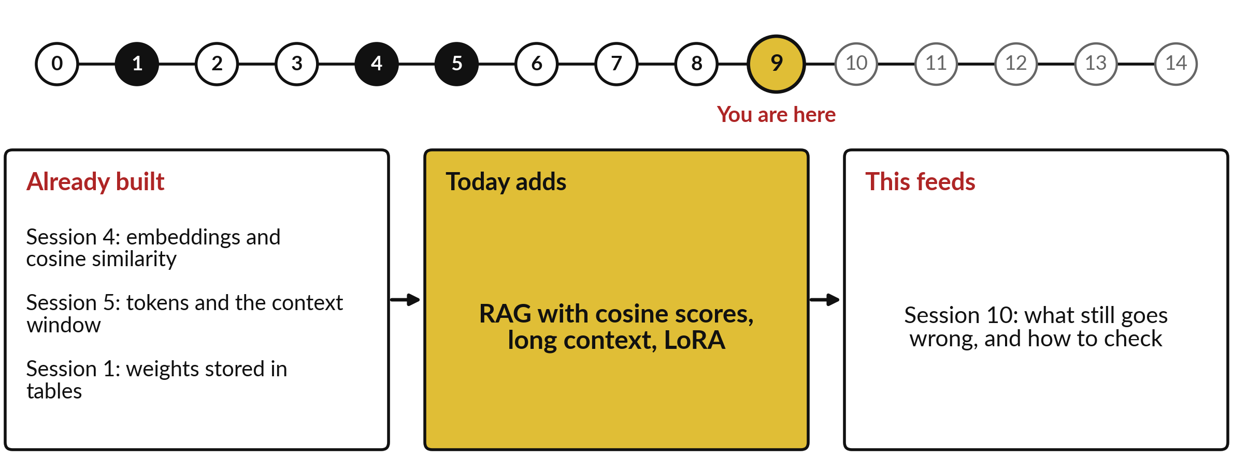
How today connects: what we
already have and what it feeds
Each session is built on the ones before it.
Notes:
So where does today sit in the story? The dots along the top are the fifteen sessions, from the map at Session 0 to your plan at Session 14, and the gold one is today.
We already hold embeddings and cosine similarity from Session 4, tokens and the context window from Session 5 and weights stored in tables from Session 1. Nothing today starts from zero.
What today adds is this: rAG with cosine scores, long context, LoRA.
And it feeds straight into what comes next. Session 10: what still goes wrong, and how to check. Keep that chain in mind, because each idea you learn today is a step on it.

Slide 6




Words we use today
Word | What it means
Retrieval-augmented generation (RAG) | A retriever fetches relevant text from your documents, and the model answers from it.
Chunk, embedding, cosine similarity | A chunk is a piece of a document. An embedding is a vector for its meaning. Cosine compares two vectors.
Top-k retrieval, vector database | Keep the k chunks with the highest scores. A vector database stores the embeddings and finds the closest fast.
Context window | The most tokens a model can read and write at one time. Long context means a large window.
Fine-tuning, LoRA, rank | Fine-tuning is more training on your examples. LoRA (low-rank adaptation) trains a small update; rank sets its size.
Notes:
Five words for today. I give the plain meaning of each, and we use every one of them before the end of the session.
Retrieval-augmented generation (RAG). A retriever fetches relevant text from your documents, and the model answers from it.
Chunk, embedding, cosine similarity. A chunk is a piece of a document. An embedding is a vector for its meaning. Cosine compares two vectors.
Top-k retrieval, vector database. Keep the k chunks with the highest scores. A vector database stores the embeddings and finds the closest fast.
Context window. The most tokens a model can read and write at one time. Long context means a large window.
Fine-tuning, LoRA, rank. Fine-tuning is more training on your examples. LoRA (low-rank adaptation) trains a small update; rank sets its size.
Keep those words close. The first idea uses them straight away, so let us begin.

Slide 7
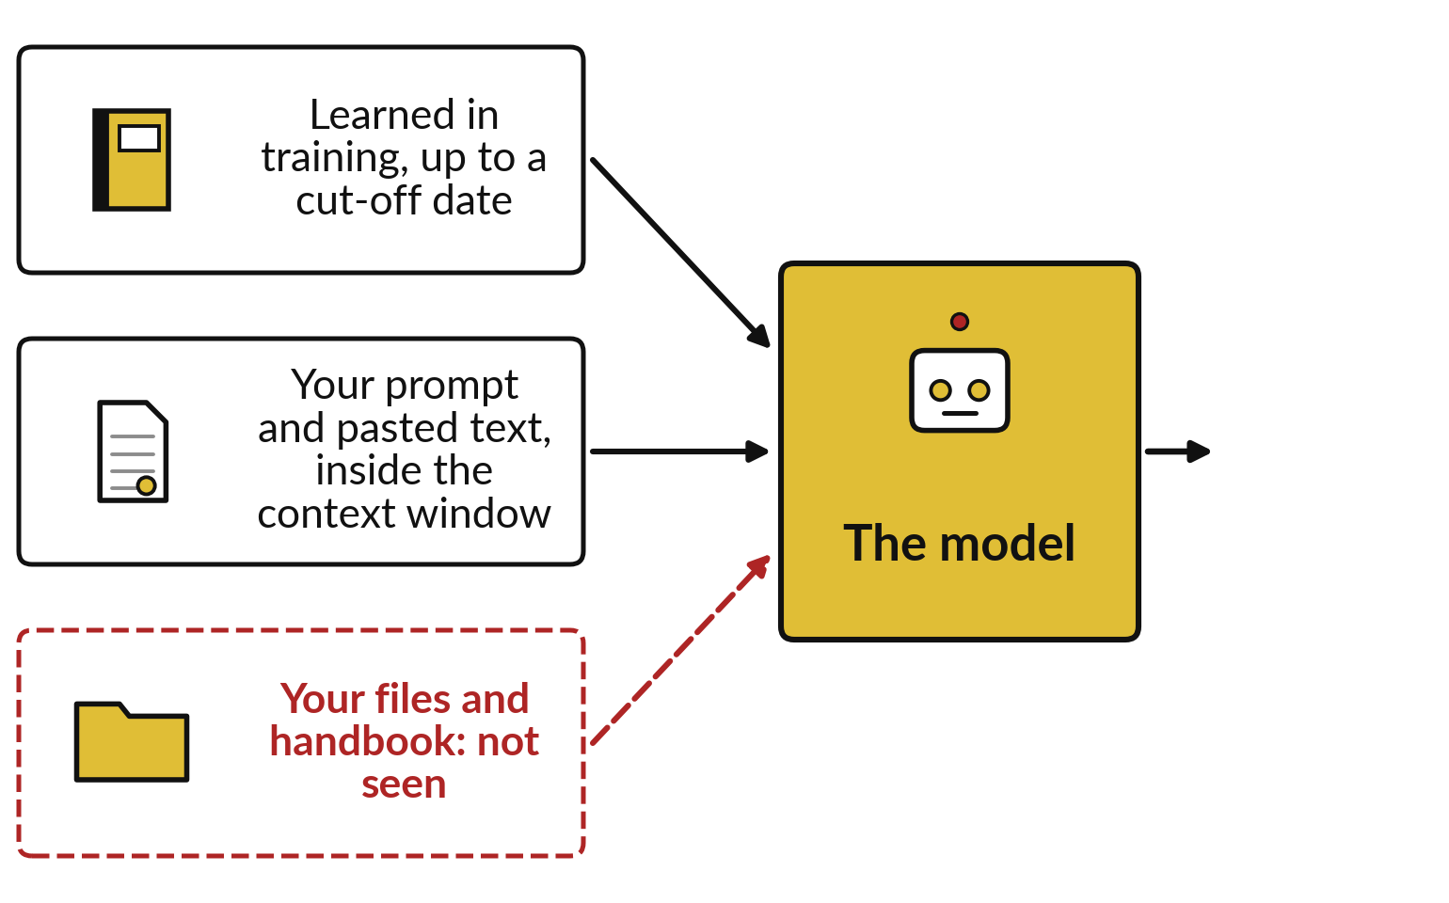
A model knows only what it learned in
training and what is in its context window
Your handbook was never in its training.
Training stops at a cut-off date.
The context window holds your prompt and pasted text.
Your files stay unseen unless you supply them.
Notes:
You now have the five words, so let me show you the problem they solve. Think of a new accountant who has just left university: clever, well read, and with no idea what your company decided last March. A model is in the same position. It learned from a huge amount of text up to a cut-off date, and the only other thing it sees is what fits in its context window, the text you send it at one time.
Your handbook, price lists and contracts were never part of its training. So today is about a single question: how does the model get to see your knowledge?
There are three ways, and they differ in cost and in what they can do. Here they are on one page.

Slide 8
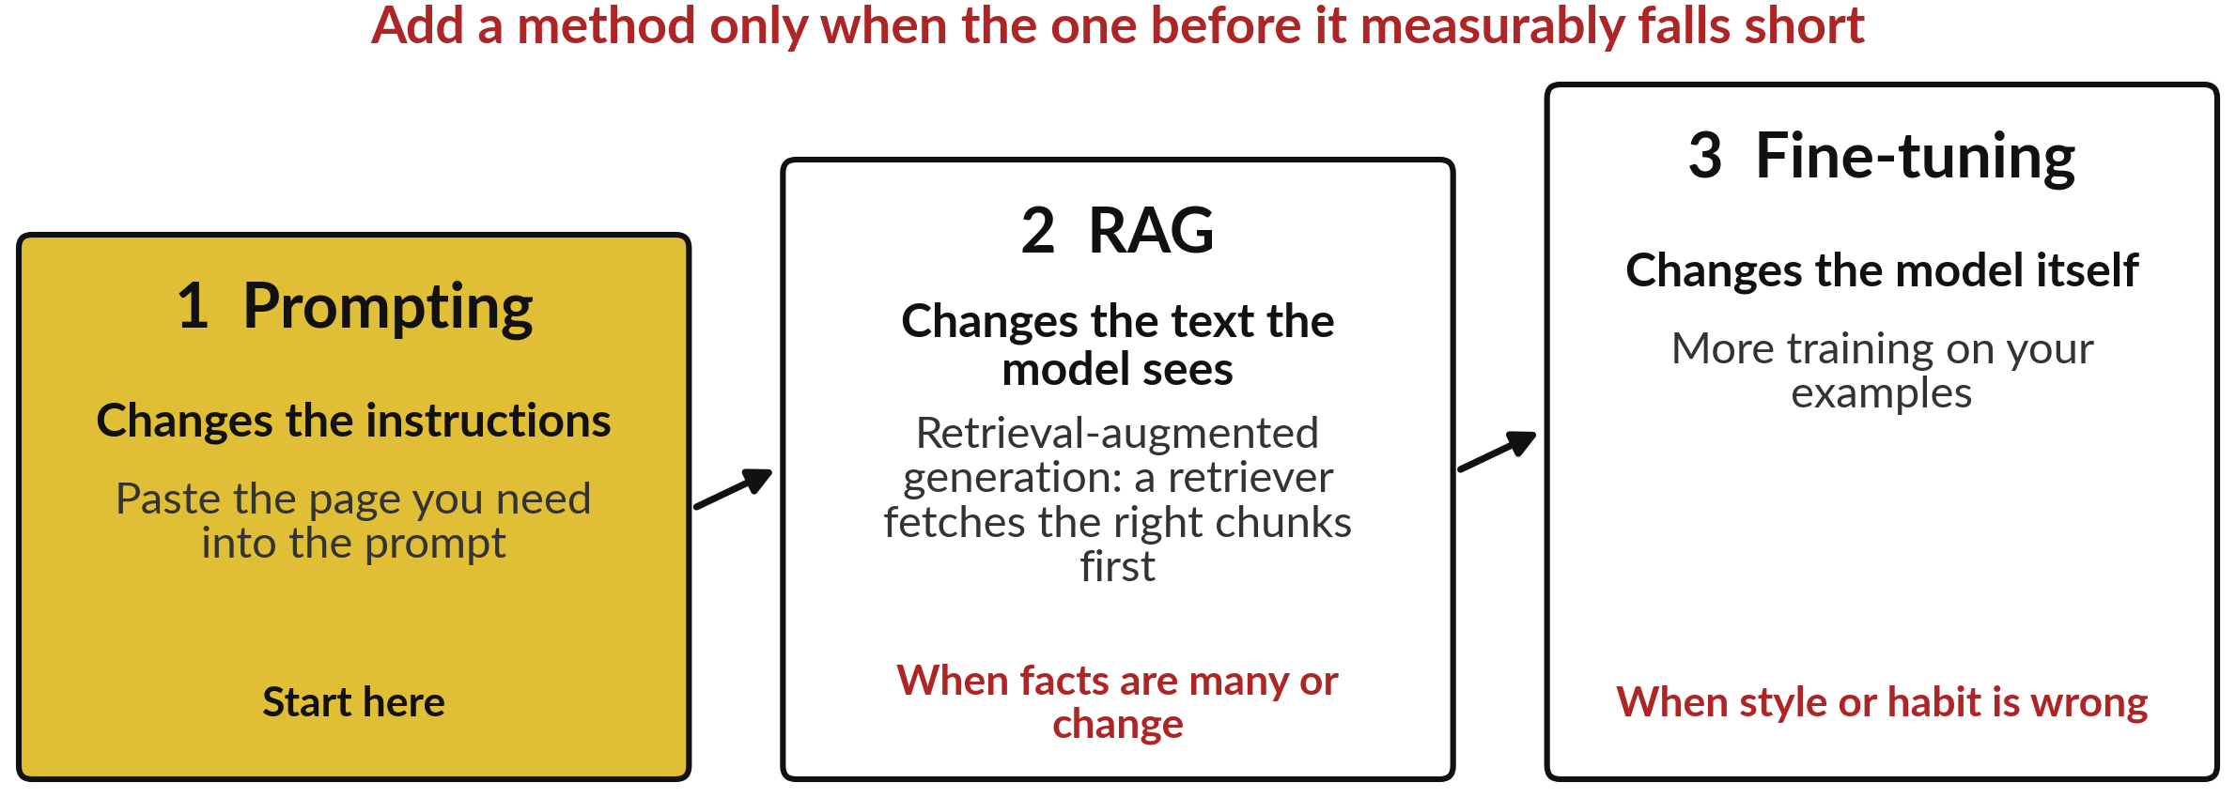
Three ways to give a model your
knowledge: prompting, RAG and fine-tuning
Source for the order: one vendor guide, checked 6 November 2026. See the notes.
Notes:
This is the plan for the whole session. First is prompting: you paste what the model needs into the prompt. Second is retrieval-augmented generation, or RAG: a retriever, which is a search step, fetches the right pieces of your documents before the model answers. Third is fine-tuning: more training that changes the model itself.
Each costs more effort than the one before. One vendor guide, from OpenAI, also says to start with prompting and a set of at least twenty checked questions, and to move on when the cheaper step falls short. That is advice from one vendor, and the logic is general: measure first, as with the evaluation set of Session 8. We start with the cheapest.

Slide 9
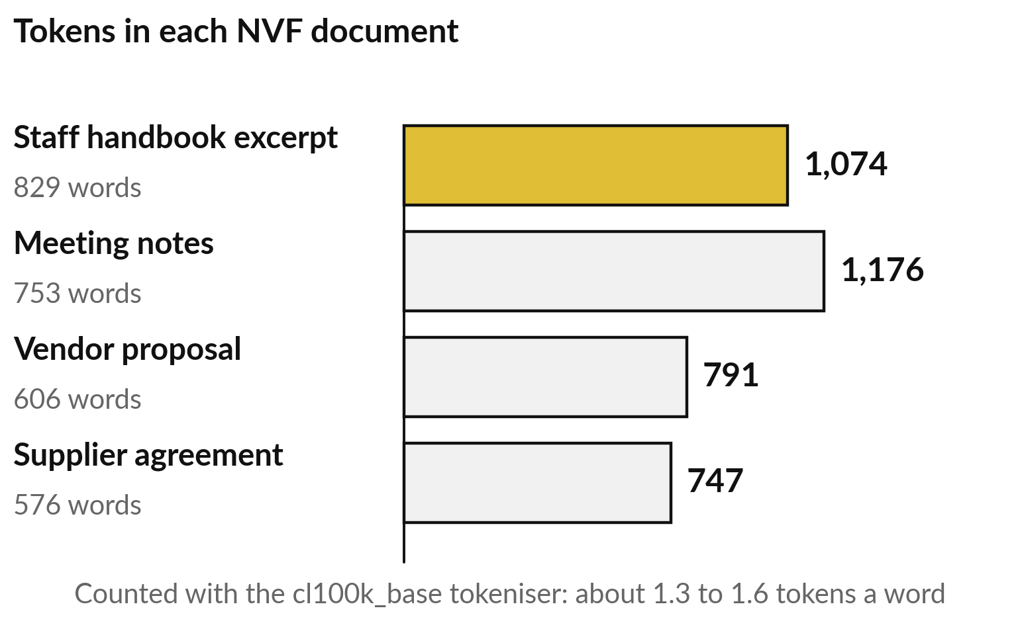
Prompting first: will the document fit?
The handbook is only 1,074 tokens
Recall Session 5: a token is a word or part of a word. The context window is the most tokens a model handles at once.
829 words made 1,074 tokens: 1,074 ÷ 829 ≈ 1.3 a word.
That fits easily in a context window.
Notes:
Prompting costs nothing but care, so the first question is whether the document fits. Two words from Session 5 answer it. A token is a word or part of a word, the unit the model reads. The context window is the most tokens a model can handle at one time, your prompt, anything pasted and its answer together.
I counted the real tokens of four NVF documents with a standard counting tool, the cl100k_base tokeniser. The staff handbook excerpt is 829 words and 1,074 tokens. Divide 1,074 by 829 and you get about 1.3 tokens a word. Models count differently, so treat the figures as an order of size.
A thousand tokens is small for today’s models. When your documents are far too many to paste, you need a way to pick out the right pages.

Slide 10
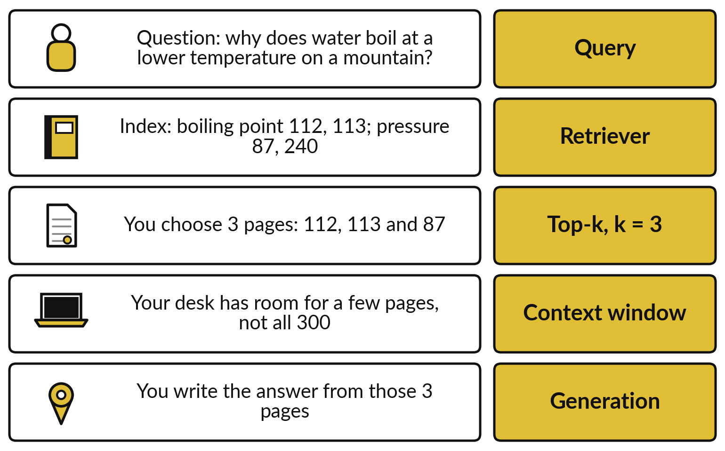
An open-book test shows the idea:
look in the index, then answer
Think of it like a 300-page textbook you may use in a test.
The whole book will not fit on your desk.
The index points to 4 pages; you keep the best 3.
You write the answer from those 3 pages.
Notes:
Before the technical version, an everyday one. Imagine an open-book test with a 300 page textbook. The question is why water boils at a lower temperature on a mountain. You cannot read the whole book in the time you have, and it will not fit on your desk.
So you look in the index, which points to four pages, and you keep the best three: 112, 113 and 87. You read those three pages and write the answer from them. The right-hand column names each step with its industry term: query, retriever, top-k, context window and generation.
The comparison has one limit: you understand the pages, while a computer only matches them by closeness of meaning. Here are the same steps as a machine does them.

Slide 11
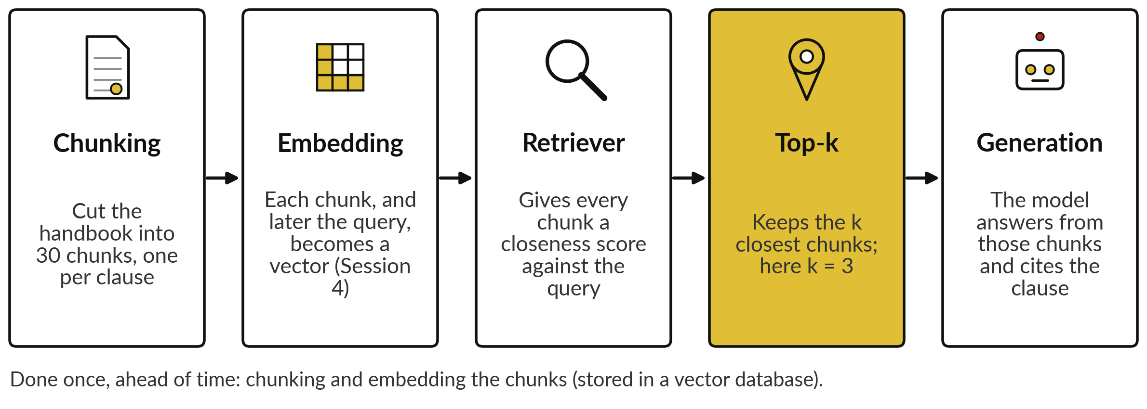
RAG does the open-book steps: chunk,
embed, score, keep the top k, then answer
The handbook run of 6 November 2026 follows these steps. Scores are built step by step.
Notes:
Here are the steps of retrieval-augmented generation in order. Chunking cuts the handbook into pieces, called chunks, here one per clause, thirty in all. Embedding turns each chunk into a vector, a list of numbers for its meaning, as in Session 4, and later the question too. Those vectors are stored ahead of time in a vector database, which can find the closest ones fast.
The retriever gives every chunk a closeness score against the question. Top-k keeps the k closest chunks, here three. Then the model writes the answer from those chunks, and it can cite the clause. Two steps decide most of the quality: where you cut, and how the score works. Cutting comes first.

Slide 12
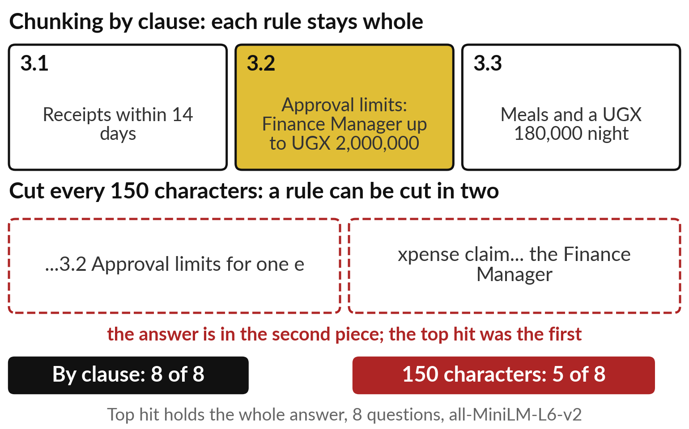
Chunking: where you cut the document
decides what the retriever can find
Chunking is cutting a document into chunks. Cut badly and a rule is split in two.
Right means the top chunk holds the whole answer.
By clause: 8 of 8 right. Every 150 characters: 5 of 8.
Notes:
The retriever can only fetch the chunks we made, so chunking is a quiet step that decides a lot. Cut a recipe through the middle of its ingredients and the index points to half a recipe. I ran the eight questions that the handbook answers three ways, and counted a question as right when the top chunk held the whole answer.
Cutting by clause kept every rule whole: eight of eight. Cutting every one hundred and fifty characters split clause 3.2 in half; the answer sat in the second piece, and the top hit was the first. That gave five of eight. Cutting every three hundred characters also gave eight of eight on this small file.
So look at your chunks, and test. Now, how is a chunk scored?

Slide 13
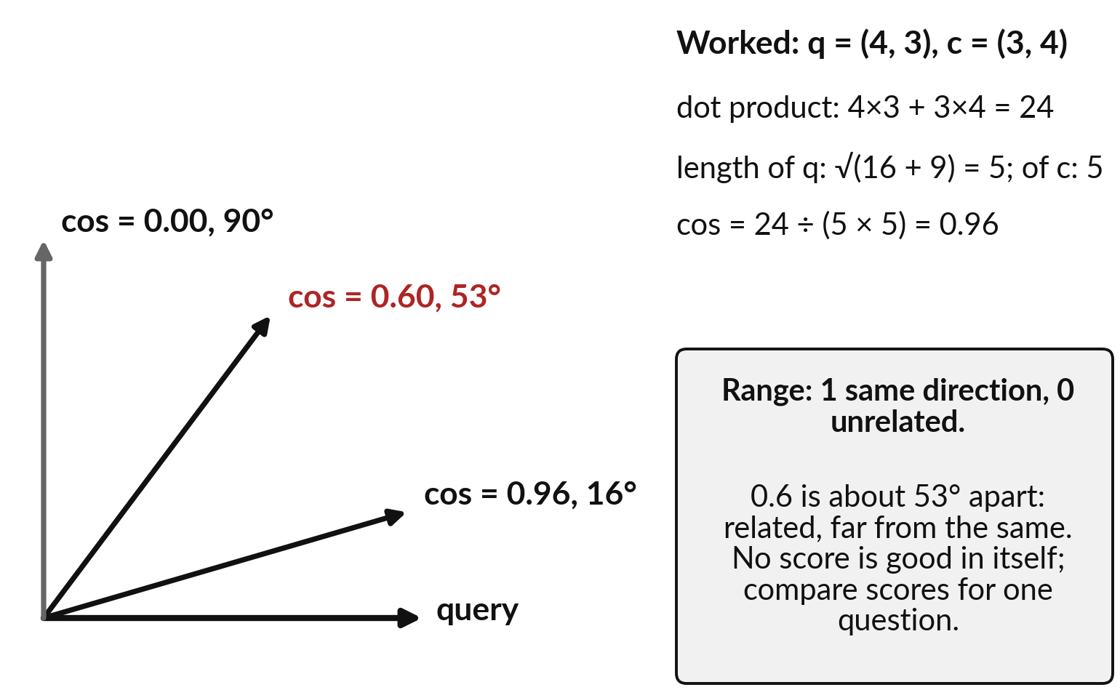
Recall Session 4: cosine similarity
scores how close two meanings are
An embedding is a vector. Cosine similarity compares the directions of two vectors.
cos = dot product ÷ (length × length).
1 is the same direction, 0 unrelated.
0.6 is about 53° apart: related, far from the same.
Notes:
The score is an old friend from Session 4, so here is a one-minute recall with two numbers per vector. Take q, the query, as 4 and 3, and c, a chunk, as 3 and 4. The dot product multiplies matching numbers and adds them: 4 times 3 plus 3 times 4 is 24.
The length of each arrow is the square root of its squared numbers added: the square root of 16 plus 9, which is 5. Cosine similarity is the dot product divided by the two lengths multiplied: 24 divided by 25 is 0.96. It measures the angle: 1 means the same direction, 0 means a right angle, unrelated.
A score of 0.6 means about 53 degrees apart: related, far from the same. No score is good in itself, so we compare scores for one question.

Slide 14
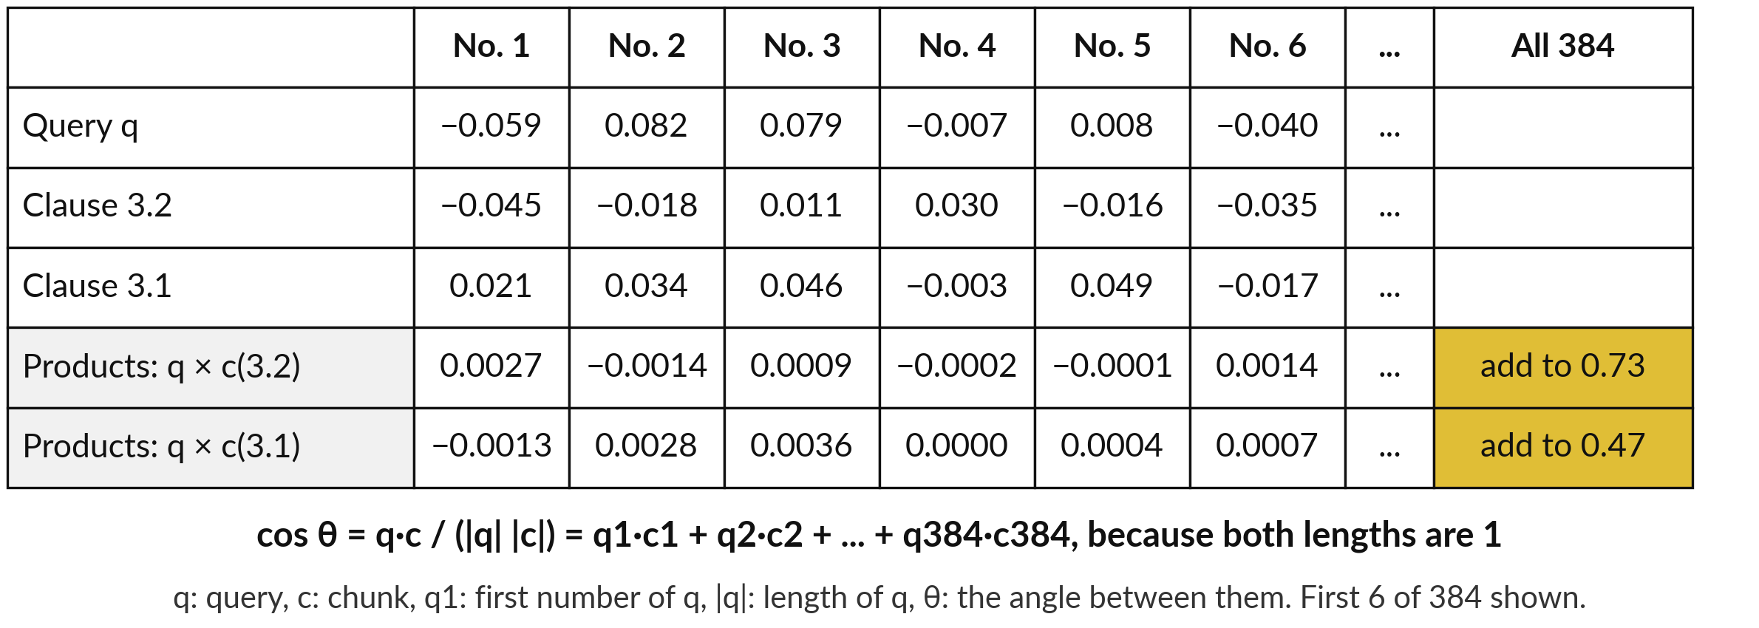
Peek inside one real score: 384 pairs of
numbers, multiplied and added, give 0.73
Recorded run, all-MiniLM-L6-v2, 6 Nov 2026. Script: peek_scoring.py.
Notes:
A real embedding has 384 numbers in place of two, and the recipe is the same. Here are the first six numbers of the question, who must approve an expense claim of 1,500,000 shillings, and of clauses 3.2 and 3.1. The small number after q, as in q1, counts the position: q1 is the first number of the query, c1 the first of the chunk.
Multiply q1 by c1: minus 0.059 times minus 0.045 is 0.0027. Do the same for all 384 pairs and add: 0.73 for clause 3.2, and 0.47 for clause 3.1. This model scales every vector to length one, so dividing by the lengths changes nothing, and the sum is already the cosine.
The theta in the formula is the angle between the two vectors. Only the final sums, compared, mean anything.

Slide 15
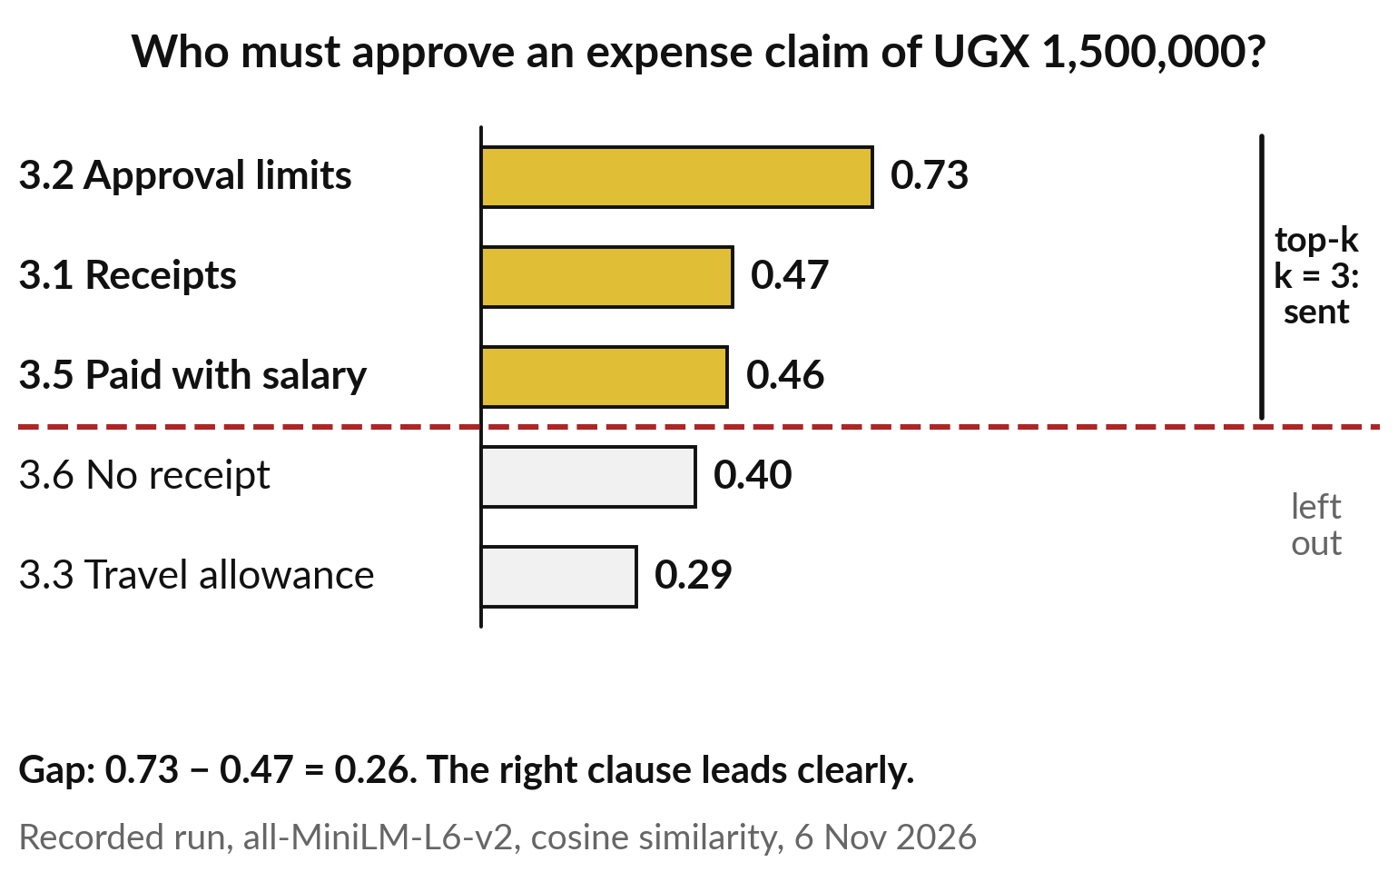
Top-k retrieval ranks the chunks by
score and sends the best k to the model
For this question the right clause scores 0.73; the next scores 0.47.
k is a number you choose; here k = 3.
The top three go into the prompt. The rest are left out.
Notes:
Now we use those scores to rank. The retriever scores all thirty clauses for the question and sorts them, highest first. Clause 3.2, approval limits, scores 0.73. Receipts, clause 3.1, scores 0.47, and clause 3.5 scores 0.46. Top-k retrieval keeps the k chunks with the highest scores and puts them into the prompt, under the question; k is a number you choose, here three.
Everything under the red line is left out. The gap between first and second is 0.73 minus 0.47, which is 0.26, so the right clause leads clearly. These are the real numbers from the run. One question is a good start, so let me run all ten.

Slide 16
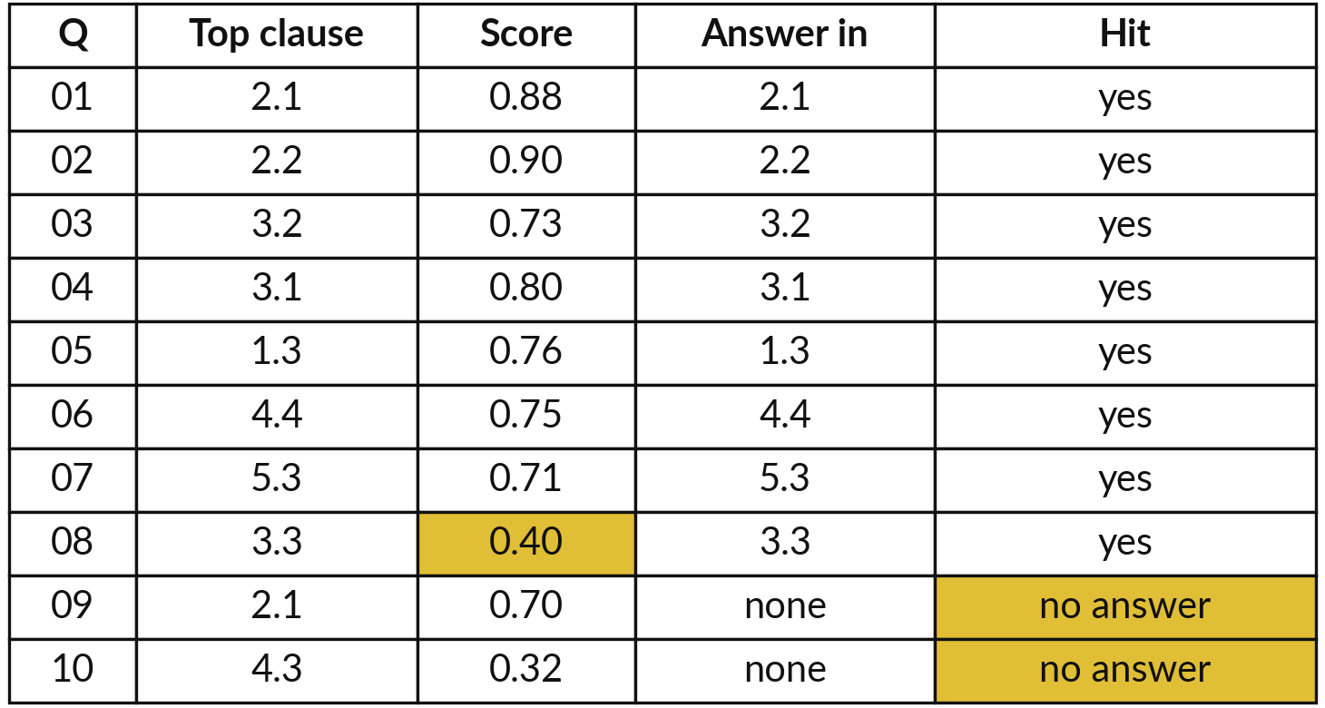
Demonstration: the retriever
on all ten handbook questions
I will show
Watch for
8 of 8 answerable questions: the right clause comes first
Q08 scores only 0.40 and is still first
Q09 scores 0.70 and has no answer
Notes:
This is a real run you can repeat on a laptop. I cut the handbook into thirty clauses, embedded them and the ten questions, and listed the closest clause for each with its cosine score. Here the thirty embeddings sit in a plain list in memory; a vector database does the same job for millions.
Watch three things. For the eight questions the handbook answers, the right clause came first every time. Question eight, about accommodation, scored only 0.40, and it was still first, because the others scored lower. And watch the last two rows. Those questions have no answer in the handbook, yet question nine still scores 0.70. Keep that in mind for what follows.

Slide 17
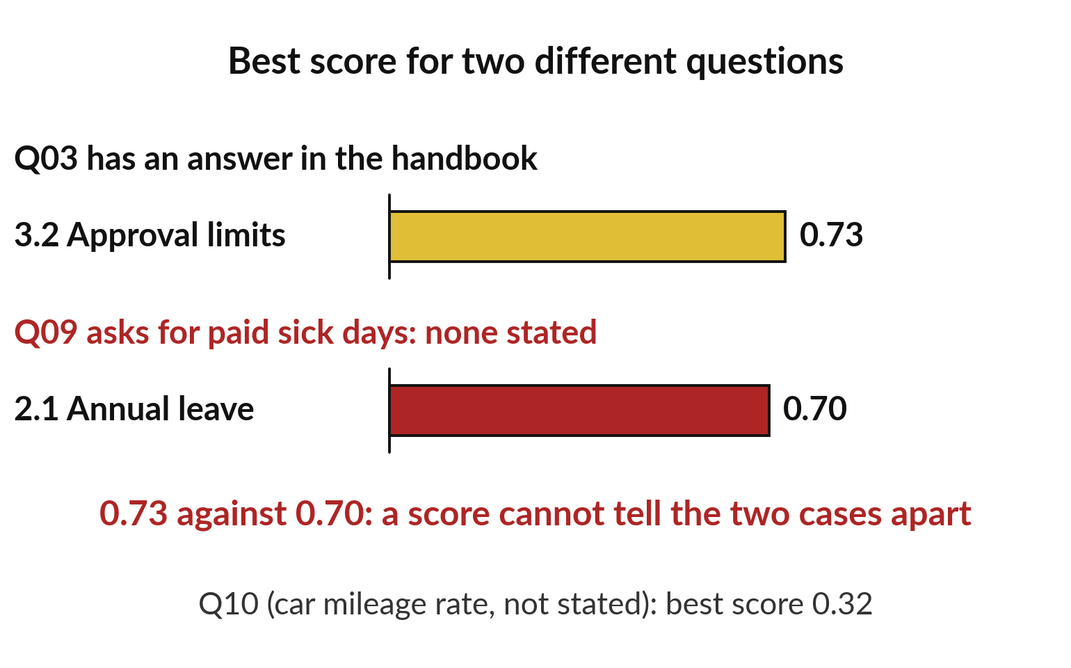
The closest page is not always an
answer, so let the model say so
A high score means the topics are close. It does not mean the answer is there.
Q09 asks for paid sick days. The handbook does not say.
0.70 for leave clause 2.1, against 0.73 for the real answer to Q03.
Notes:
What did you notice in those last two rows?
A clause came back even where the handbook has no answer. That is a retrieval limit you must know. Question nine asks how many days of paid sick leave staff get. The handbook gives no number. Yet the closest clause, annual leave, scores 0.70, almost the same as the 0.73 for a question that does have an answer.
Both are about leave, so their directions are close. So a score alone cannot tell you whether the answer is present. In the recorded runs the assistant read the pages and wrote not stated. That is why your instructions must allow that answer, a constraint from Session 8, and why you test it.

Slide 18
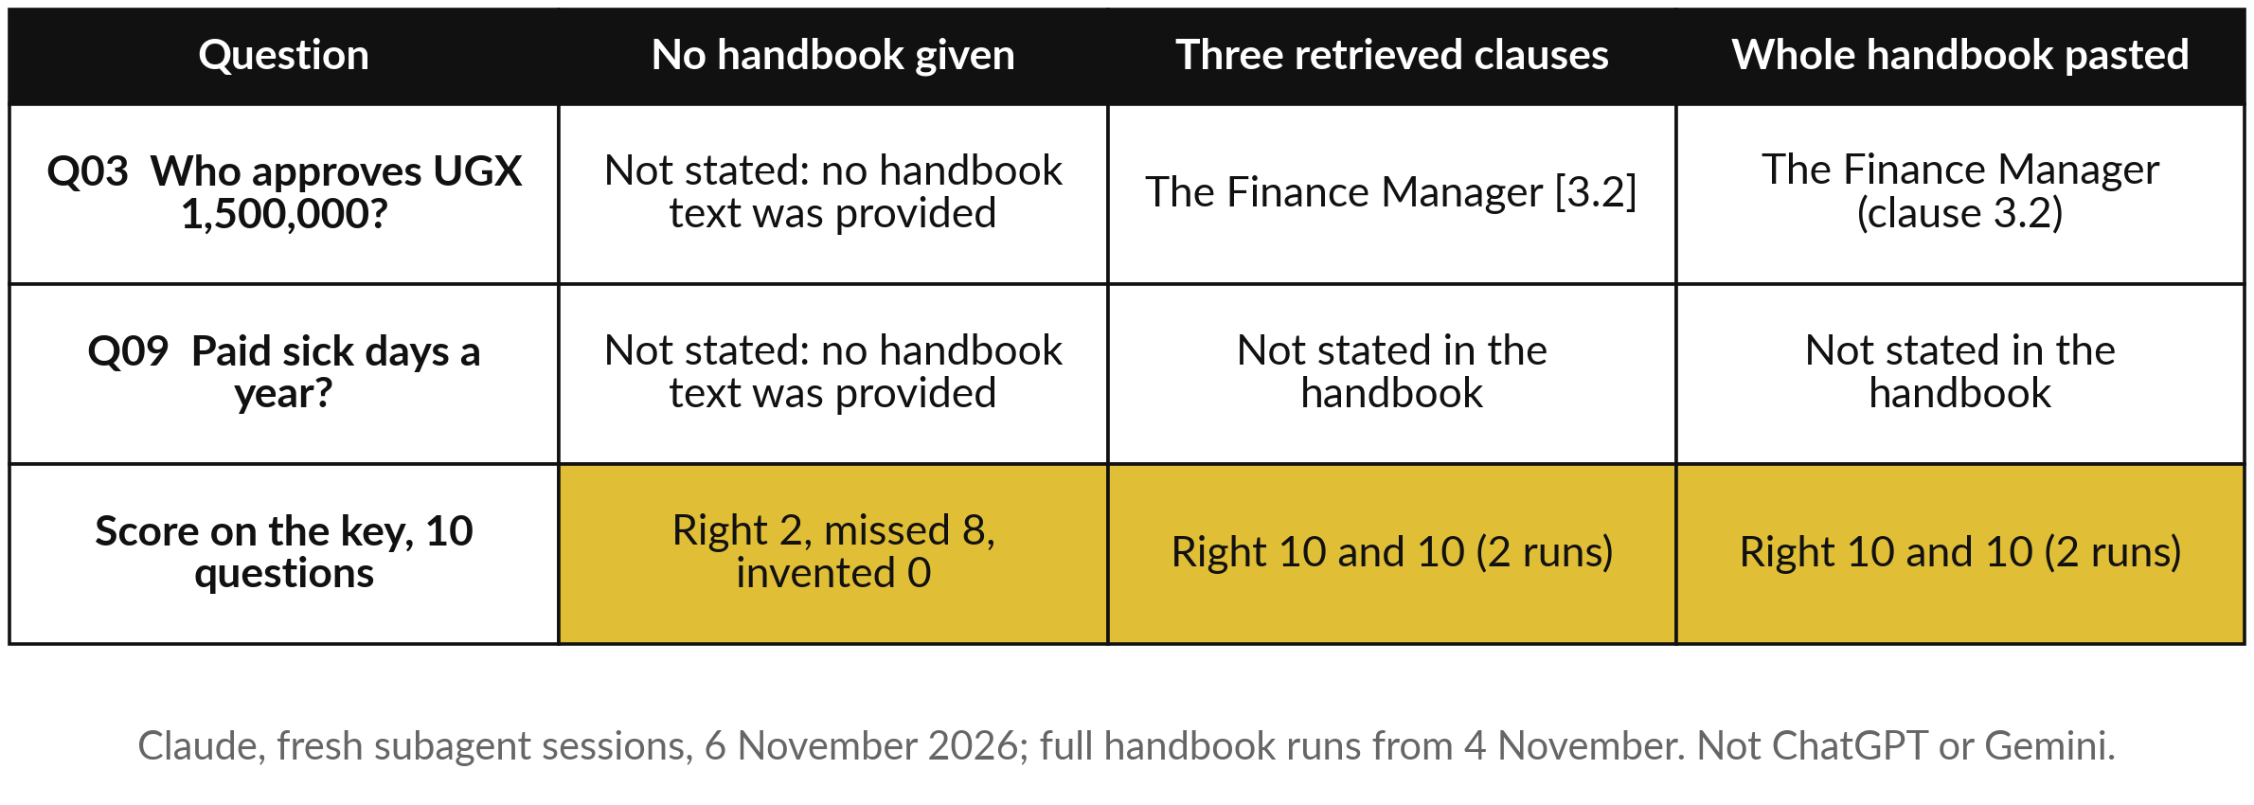
The same questions with no handbook,
three retrieved chunks, and the whole text
Scored as in Session 8: right answers out of ten. For Q09 and Q10 the right answer is not stated.
Notes:
Let me show you what the recorded runs did with those pages, scored as in Session 8: right answers out of ten. With no handbook, the assistant said not stated for all ten questions, in two runs, and invented nothing. That earns two right, only because questions nine and ten really are not stated.
With the three retrieved clauses per question, it scored ten of ten in both runs. With the whole handbook pasted in, ten of ten in both runs. These are fresh Claude sessions, not ChatGPT or Gemini, and another product may behave differently. So on this small file, pasting everything and retrieving three clauses did equally well.
When does that change?

Slide 19
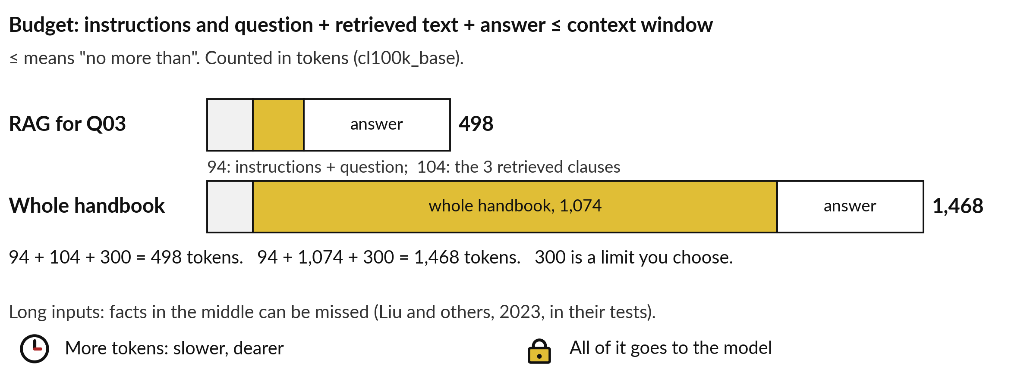
Long context: you can paste a lot, but
everything must fit the context window
Recorded counts, tiktoken cl100k_base, 11 Nov 2026. Other tokenizers count differently.
Notes:
Pasting everything is called long context. Think back to the open-book desk: long context is a bigger desk, and models now accept long inputs, so you could paste a whole contract. One rule sets the limit, and it uses the context window we recalled earlier. In words: the instructions and question, plus the pasted or retrieved text, plus the answer, must be no more than the context window.
The symbol that looks like a bent less-than sign means no more than. For Q03, the instructions and question are 94 tokens, the three clauses 104, and I allow 300 for the answer: 498 in all. With the whole handbook: 94 plus 1,074 plus 300 is 1,468. A study by Liu and colleagues found models used the start and end of long inputs better than the middle, in their tests. And more tokens mean slower and dearer answers.

Slide 20
Long context or RAG: compare
them on the same question
 | Long context: paste it all | RAG: retrieve the top k
Tokens for Q03 | 1,468 | 498
Set-up work | None: paste the file | Chunk, embed, store, test
How much knowledge | What fits in the window | Thousands of files
Can miss | Facts in the middle of a long input | A chunk the retriever ranks low
Files that change | Paste the new version | Embed the changed chunks again
Shows the source | If you ask for it | The clause it retrieved
Paste what fits and still answers well. Retrieve when it does not.
Notes:
So which one, paste the whole document or retrieve the chunks?
Here are the trade-offs on the same question. Long context sent 1,468 tokens, RAG 498, so RAG is cheaper per question. Long context needs no set-up; RAG needs chunking, embedding, storing and a test set. Long context holds only what fits the window; RAG can search thousands of files.
Each can miss: long context the facts in the middle, RAG a chunk the retriever ranks low. When files change, you paste the new version, or embed the changed chunks again. Anthropic makes the same point in its write-up on retrieval: for a small knowledge base you can simply put it all in the prompt.
Both of these bring documents to the model. The third way changes the model itself.

Slide 21
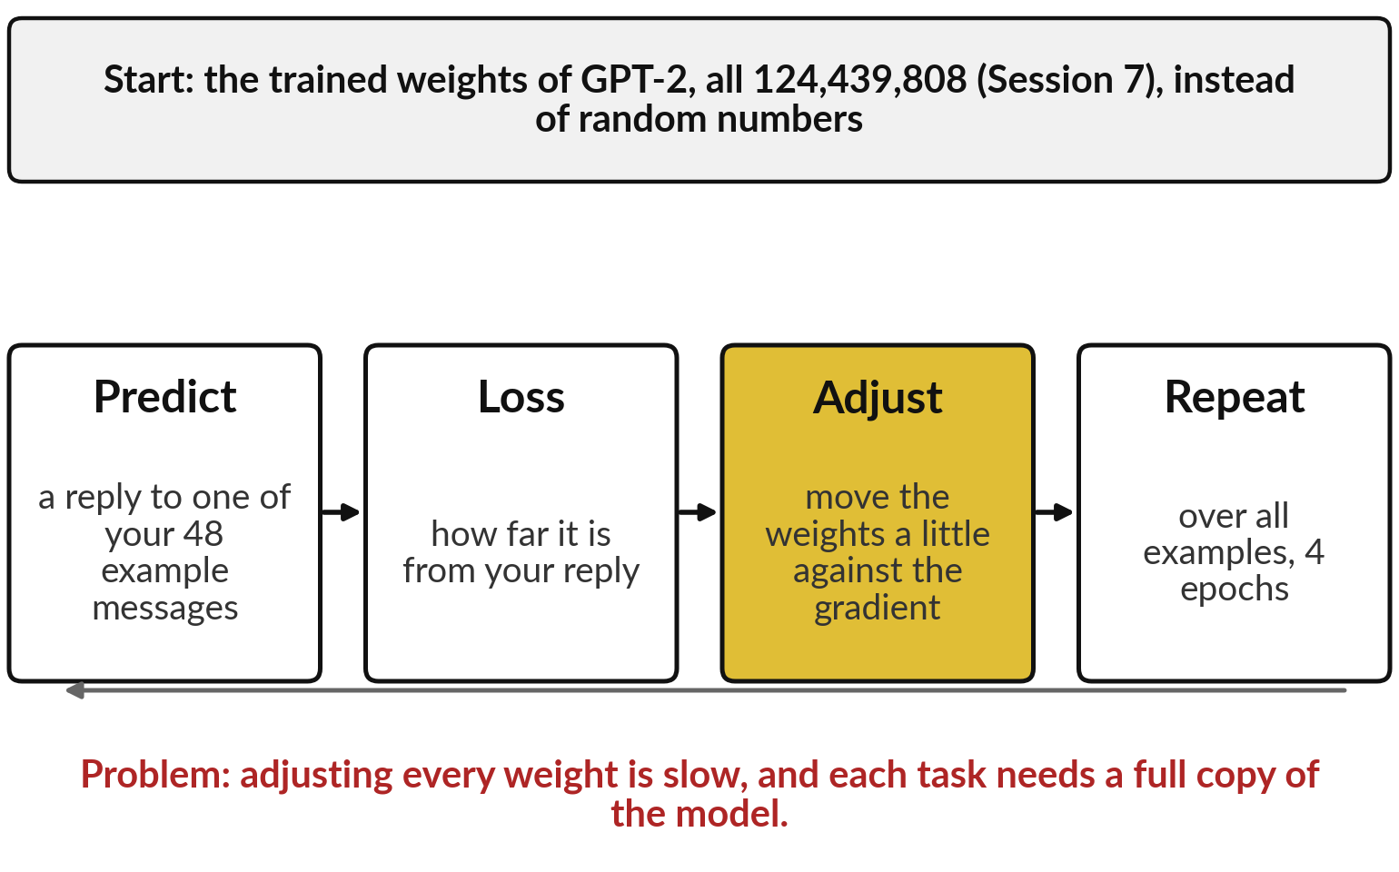
Fine-tuning is the Session 0 training loop,
started from weights already trained
The weights are the numbers of Session 1. Fine-tuning adjusts them with your examples.
Prompting and RAG change what the model reads. Fine-tuning changes the model.
Think of a tailor altering a ready-made suit.
Notes:
Fine-tuning needs no new idea, only two old ones. From Session 1: a model is made of weights, numbers that say how much each input counts. From Session 0: training is a loop. Predict, measure the loss, which says how wrong the prediction was, adjust the weights a little against the gradient, and repeat.
Fine-tuning runs that same loop, starting from weights that are already trained, here all 124,439,808 of GPT-2 from Session 7, on your own examples, here forty-eight replies in one house style. Think of a tailor with a ready-made suit: the cloth stays, small alterations make it fit. The problem: adjusting every weight is slow, and each task needs its own full copy.
To see the cheaper way, we need to look at how weights are stored.

Slide 22
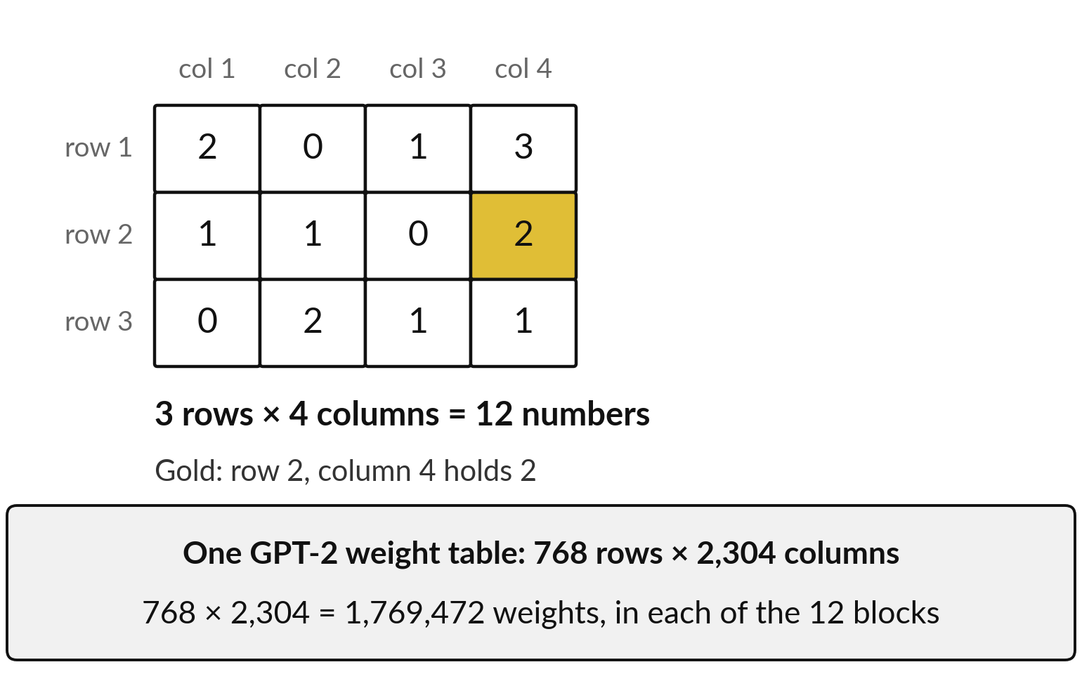
The weights sit in tables of
numbers called matrices
A matrix is a table of numbers: rows times columns. As in Session 1, a layer’s weights form one table.
3 rows × 4 columns = 12 numbers.
One GPT-2 table: 768 × 2,304 = 1,769,472.
Notes:
In Session 1 you saw that a layer of neurons is a table: one row of weights for each neuron. Mathematicians call a table of numbers a matrix. Its size is the number of rows times the number of columns. This small one has three rows and four columns, so it holds three times four, twelve numbers, and the gold cell sits in row two, column four, holding the number two.
GPT-2 stores its weights in tables like this, only bigger. The one we fine-tune today has 768 rows and 2,304 columns: 768 times 2,304 is 1,769,472 weights, and there is one such table in each of GPT-2’s twelve transformer blocks from Session 5. Changing all of them is the expensive part.
Is there a smaller way to change a big table?

Slide 23
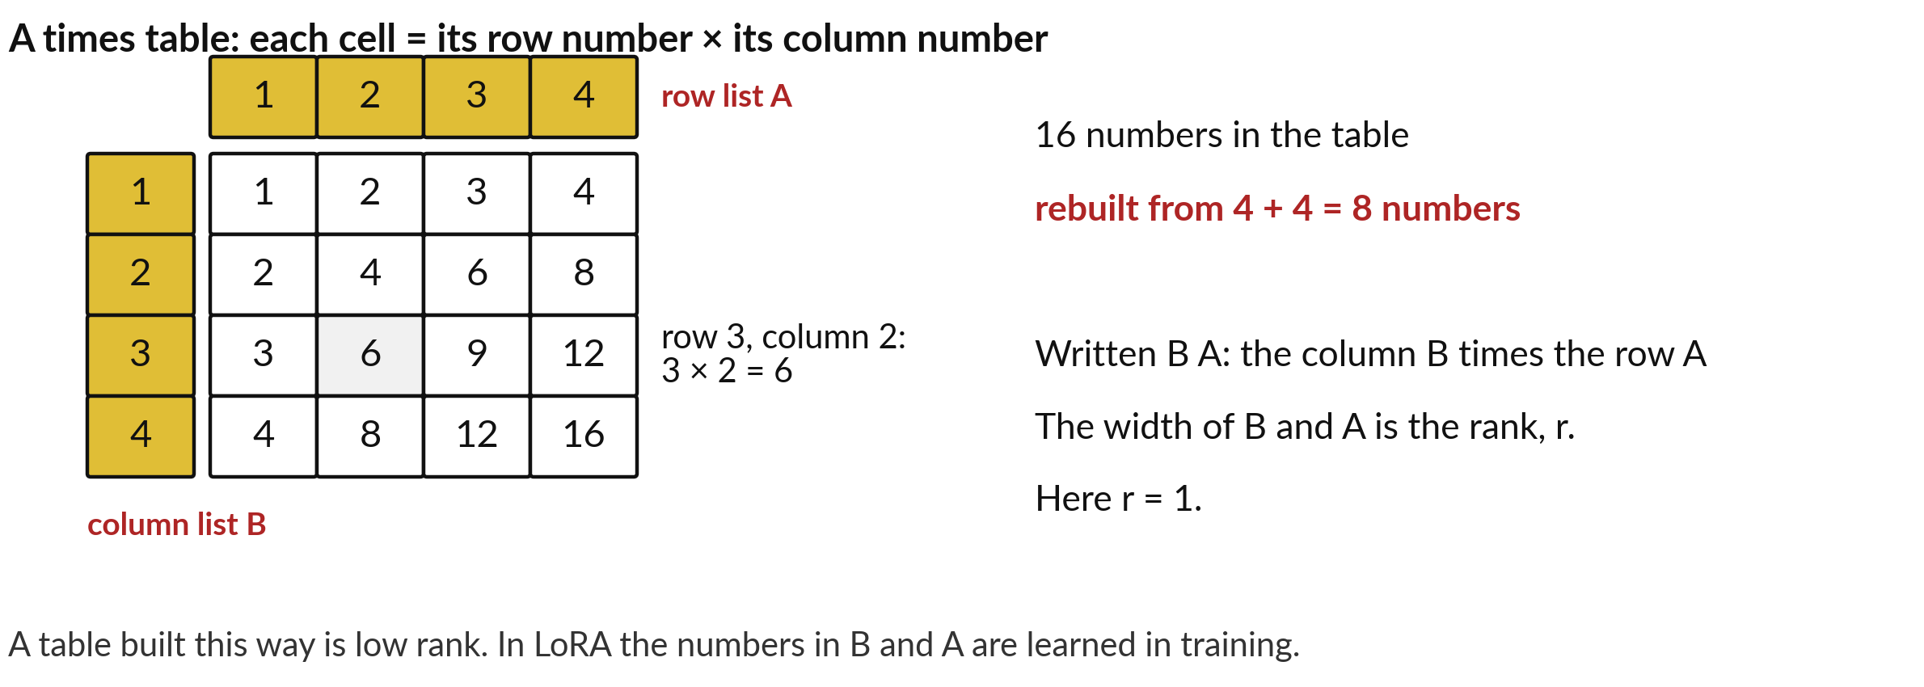
A low-rank table is rebuilt from one
column and one row, like a times table
Rank r: how many column-and-row pairs are added together. Here r = 1.
Notes:
There is, and you learned it at primary school. A times table has sixteen numbers here, yet you can rebuild every one from two short lists: the column 1, 2, 3, 4 and the row 1, 2, 3, 4. Each cell is its row number times its column number: row three, column two is three times two, six.
So sixteen numbers come from four plus four, eight. We write the column as B and the row as A, and the table they build as B A, B times A. A table built this way is called low rank. The rank, r, is how many column-and-row pairs are added together; here there is one, so r equals one.
In LoRA the numbers in B and A are learned in training. Next, how that update is added.

Slide 24
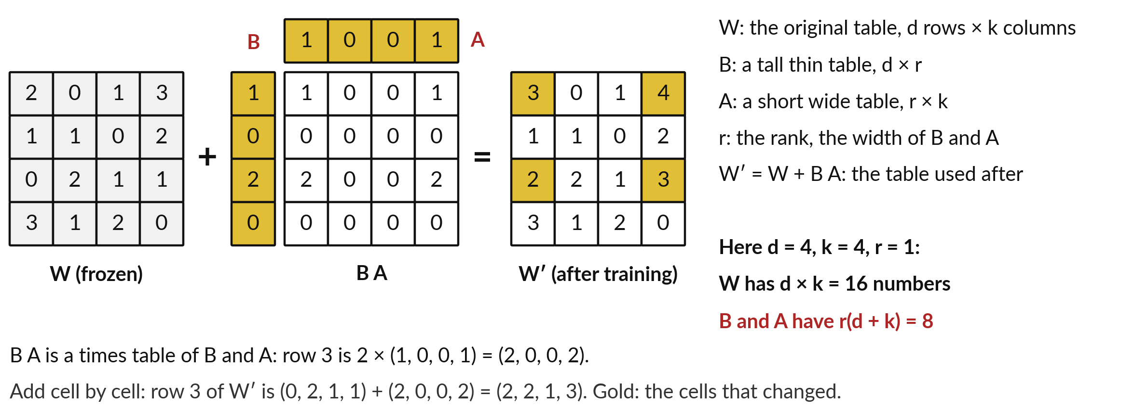
LoRA, low-rank adaptation: keep the table
W frozen and learn a small low-rank update
A made-up 4 × 4 example. Real LoRA also multiplies B A by a fixed number, left out here.
Notes:
Here is LoRA, low-rank adaptation, from a 2021 paper by Hu and colleagues, on a four by four table. W is the original weight table, frozen: training never changes it. B is a tall thin column, A a short wide row, and B A is their times table: row three is 2 times 1, 0, 0, 1, which is 2, 0, 0, 2.
W prime is W plus B A, added cell by cell: row three becomes 0 plus 2, 2 plus 0, 1 plus 0, 1 plus 2, so 2, 2, 1, 3. In words, the new table equals the old table plus the low-rank update. Count: W has d rows times k columns, sixteen numbers.
B and A have r times the sum of d and k, one times eight, eight numbers. Only those eight are trained. Now the same count with GPT-2’s numbers.

Slide 25
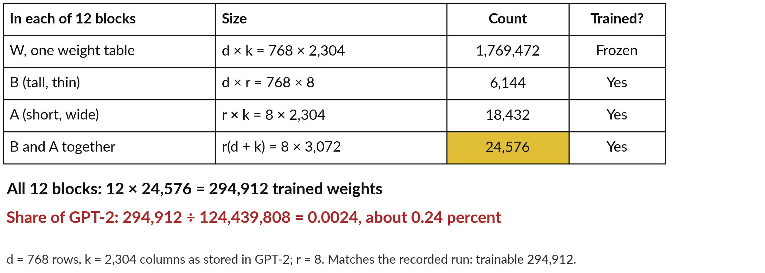
With GPT-2’s numbers: 24,576 per
block, 294,912 in all, 0.24 percent
Recorded run: demo_runs/s09/lora_output.txt. Arithmetic: demo_runs/s09/check_numbers.py.
Notes:
Same count, real sizes. In each block, W has d equal to 768 rows and k equal to 2,304 columns: 1,769,472 numbers, frozen. My run used rank r equal to 8, so B is 768 by 8, which is 6,144 numbers, and A is 8 by 2,304, which is 18,432.
Together, 6,144 plus 18,432 is 24,576. The formula gives the same: r times the sum of d and k is 8 times 3,072, which is 24,576. GPT-2 has twelve blocks, and twelve times 24,576 is 294,912. Divide by all 124,439,808 weights and you get 0.0024, about a quarter of one percent.
Only those move in training, and the recorded run reports exactly 294,912 trainable weights. So what can such a small update learn?

Slide 26
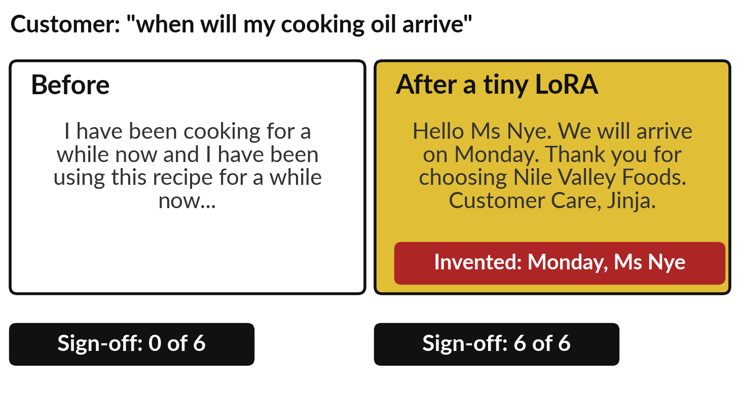
Demonstration: a tiny LoRA
learns a house sign-off
I will show
Watch for
Sign-off present: 0 of 6, then 6 of 6
Style is learned
Facts are invented: "Monday" and the name
Notes:
This is a real run of that tiny experiment on GPT-2, with forty-eight invented replies in one house style, four passes over the examples, which are four epochs. Watch two things: the sign-off, and the facts. Before training, none of six new messages got the house sign-off, and the text wandered.
After training, all six ended with the sign-off. Now read the replies. The model promised to arrive on Monday and greeted a Ms Nye, and nobody told it either. Another reply invented a cancellation on Wednesday. It learned the style. It did not learn facts. The model is tiny and the data is invented, so this shows the idea; a real product may behave differently.

Slide 27


RAG supplies facts. Fine-tuning shapes habits.
Use RAG for
Use fine-tuning for
Facts that change
Answers that cite a clause
Private documents
A steady format or tone at volume
A task the prompt cannot teach
Examples you own and may use
Fine-tune only after prompting and RAG measurably fall short.
Notes:
What did you see in those six replies?
The sign-off came back every time, and the facts did not. That gives us the rule. RAG supplies facts: the model reads the chunk and can cite the clause. Fine-tuning shapes habits: a tone, a format, a way of working, because the update to the weights learns patterns across many examples.
The same vendor guide I mentioned says use RAG when the model lacks knowledge, and fine-tuning when output is inconsistent or the format is wrong. It also says the methods can be combined, as long as each earns its place. And the examples you train on must be yours to use, with personal data removed. One habit decides when to climb, and it comes next.

Slide 28
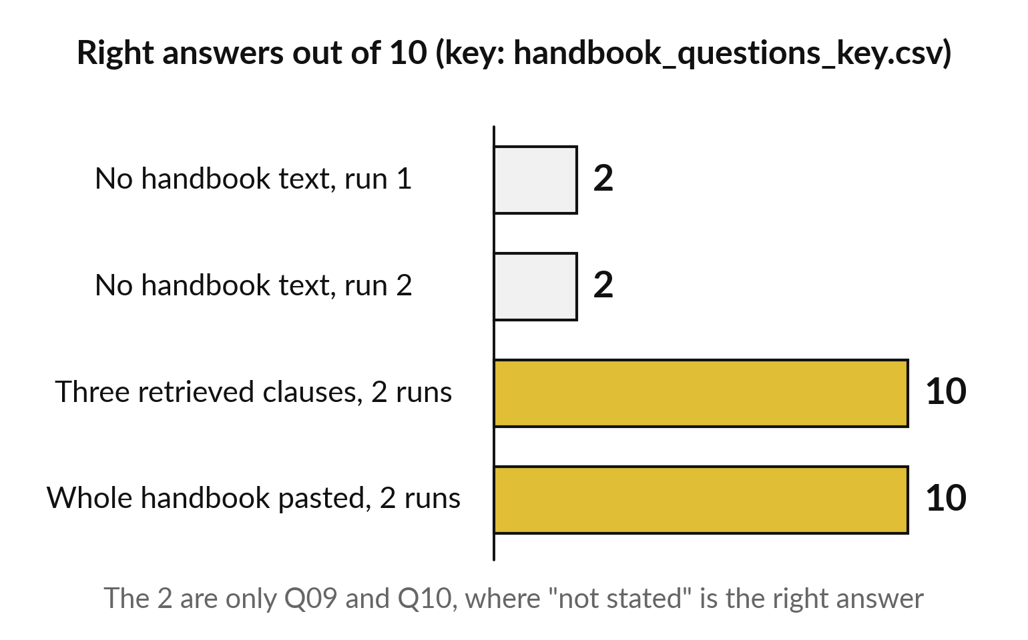
Measure each method on ten checked
questions before you add the next
Use the same ten questions and the same key every time.
Two of ten here is two honest "not stated" answers.
A method earns its place only if it moves this score.
Notes:
Before you use that rule, one habit decides every step: measure each method, as you scored prompts in Session 8. With no handbook the assistant scored two of ten, twenty percent, and those two are only the questions where not stated is the right answer. Pasting the text or retrieving three clauses scored ten of ten.
So on this set the cheapest method that works is pasting or retrieving, and fine-tuning would add nothing. Keep ten questions with known answers; the vendor guide suggests twenty or more for a serious test, and ten is a workable start. Run the cheap method, then the next, and compare.
Your own set may say something different. Session 10 turns this into a routine.

Slide 29
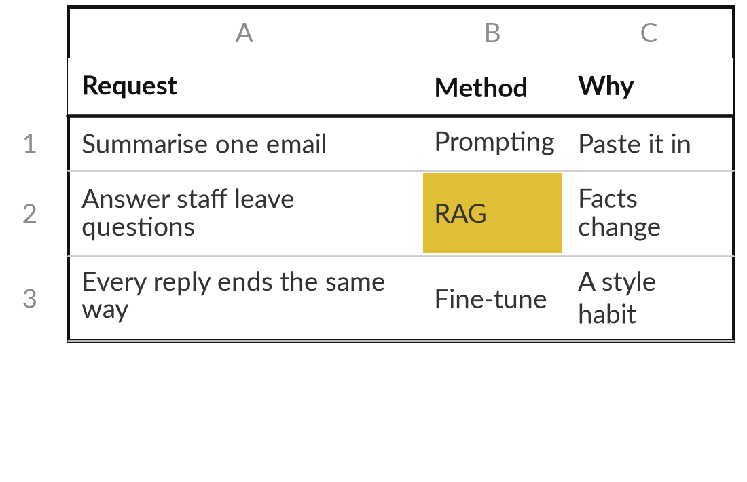
Choose the method for six
requests from Nile Valley Foods
20 minutes
Hands-on, no computer
Pick prompting, RAG or fine-tuning for each request, and say what test would show the cheaper method falls short.
Read the six requests on your worksheet.
Write P (prompting), R (RAG) or F (fine-tuning), with a reason.
Write the ten-question test you would run first.
Compare with a partner or with me.
You keep: A completed method sheet and one test you could run next week.
Notes:
You have the rule, so now you use it, on paper and with no computer, for twenty minutes. Your worksheet has six requests from Nile Valley Foods, from summarising one email to answering staff questions from a changing handbook. For each, choose prompting, RAG or fine-tuning and give one line of reason.
Then write the ten questions you would use to test the cheaper method first. Work alone for about twelve minutes while I walk round, and then compare with a partner or with me. If you disagree, the useful question is what measurement would settle it.

Slide 30




Where would each method
help or hurt in your own job?
Which request in your job needs your knowledge, and which method does it need?
Prompt
RAG
Fine-tuning
Test first
Prompting alone: one short document or a few rules, pasted each time
Many or changing documents, and answers that cite the source
A steady style at volume, with examples you may use
You have no checked questions yet, so write ten
Write the request, your chosen method and the ten-question test you will write.
Notes:
You have just made that choice for Nile Valley Foods; now make it for your own work, in about ten minutes. Pick one request where the model needs your knowledge: a policy question, a contract clause, a supplier price, a reply in your house style. Which method does it need?
Prompting only, if one short document will do. RAG, if the documents are many or change. Fine-tuning, if the style is the problem and you hold examples you may use. Or test first, if you cannot yet say how you would know the answer is right. Write the choice and the reason.

Slide 31
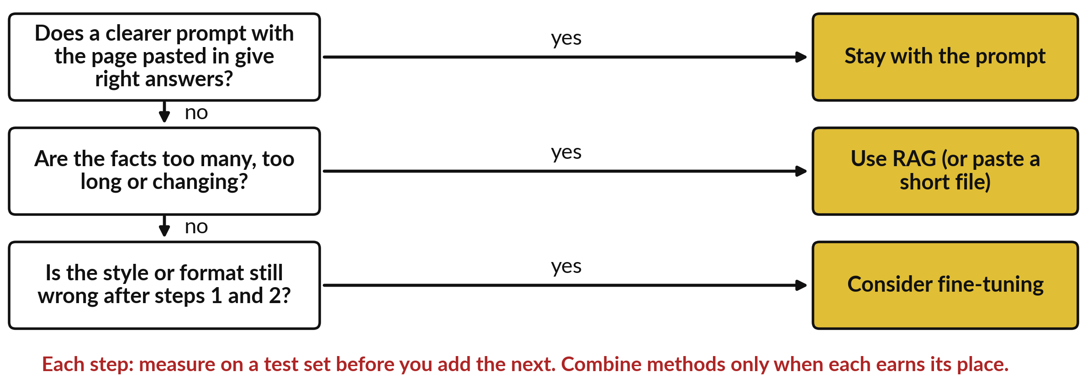
Take-away: three questions, in this
order, before you build anything
Keep this page. Session 10 shows how to run the test set.
Notes:
You have now made the choice twice, so here is the page that puts it into three questions to keep. First, does a clearer prompt with the page pasted in give right answers on your ten questions?
If yes, stop. Second, are the facts too many, too long or changing?
Then use RAG, and look at your chunks and scores. Third, is the style or format still wrong after the first two?
Then consider fine-tuning, with LoRA and examples you own. At every step you measure on a checked set before you add the next method.

Slide 32
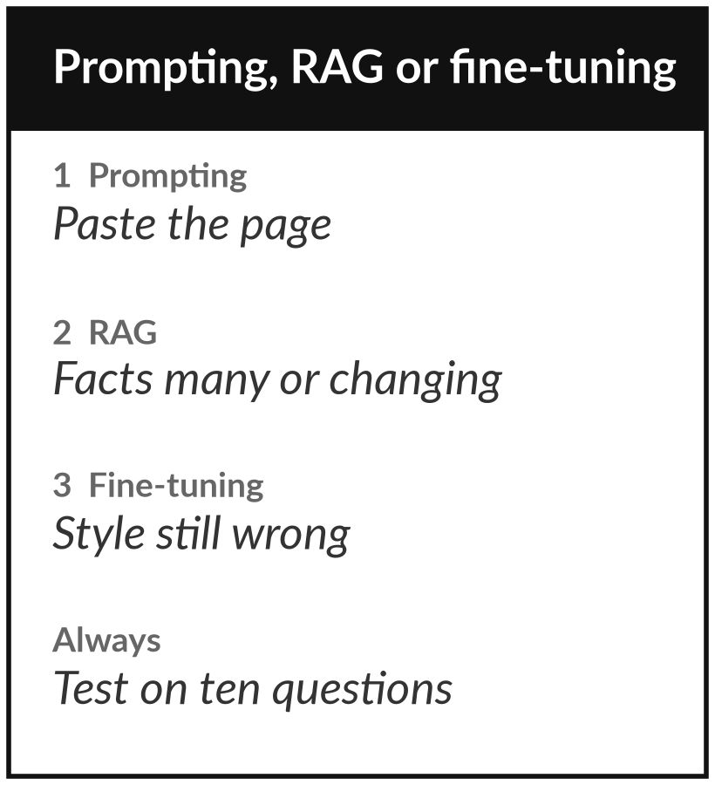
Keep the decision tree: add one method at a time
What you keep from today
A one-page decision tree: prompting first, then retrieval-augmented generation (RAG), then fine-tuning, and the test that tells you when to move on.
Our question today
How do I give an AI model my company’s knowledge, and when is each way worth it?
Next session
Session 10: When models fail, and how to check them. Optional: note one AI answer at work that you were not sure about.
Notes:
That is the ladder, so here is what you keep. Take the one-page decision tree and put it next to your own list of requests. The rule is simple to say and hard to follow: prompting first, then RAG, then fine-tuning, and move on only when the cheaper step measurably falls short on your ten questions.
Next time we look at how models fail and how to check them, and the ten questions we used today become your test set.
We began with this question: How do I give an AI model my company’s knowledge, and when is each way worth it? Before you go, say in one sentence what you can now say about it.

